Slide 1
Integrated Transcriptomic Analysis of Human Tuberculosis Granulomas
Irina St. Louis, PhD
GITHUB submission
Here, we present a bioinformatics and biostatistical pipeline for RNASeq data analysis, which was performed on data extracted from GEO (accession code GSE174443) ¹.

Slide 2
Background
Samples description: 24 lymph node biopsy samples from treatment-naive patients (7 - tuberculous granulomas, 10 – sarcoidosis granuloma, 7 – normal control tissues) were sequenced on Ion AmpliSeq instrument (Ion Torrent) ².
24 FastQ files were aligned using kallisto (v. 43.1) and the human transcriptome was annotated to gene level (GRChg38) and normalized using TMM (trimmed mean of M value) normalization (edgeR, v. 3.24.3) ^{1, 2}.
All statistical analyses were performed in RStudio (Built 351), including graphs and plots, and presented below.
The goal of this exploratory study was to assess the differences in gene expression between tuberculosis, sarcoidosis and normal control biopsies, and classify gene expression signature according to tissue type ².

Slide 3
Source Outline
Packages
library(edgeR)
biocLite (GEOquery)
library(GEOquery)
library(Biobase)
library(plyr)
library(gplots)
library(limma)
library(impute)
library(fpc)
library(gplots)
library(Biobase)
library(annotate)
library(multtest)
library(MASS)
library(lda)
library(EMV)
Library(grepl)
library(gdata)
library(matrixStats)
library(plyr) library(class)
library(kernlab)
https://www.ncbi.nlm.nih.gov/geo/query/acc.cgi?acc=GSE174443 ¹
Background
Dataset Upload
Visualization and Removal of Outliers
Group Selection
Differential Gene Expression (DEG) Analysis and Visualization
Dimensionality Reduction Methods
Classification
Selection of Differentially Expressed Transcripts
Functional Annotation
Conclusions
References

Slide 4
#Visualizing outliers
#Average Correlation Plot
outlier
SC, biopsy of sarcoidosis granulomas,
TB, biopsy of tuberculous granuloma,
Control, normal lymph node tissue biopsy

Slide 5
#Visualizing outliers
#Hierarchical Clustering Dendrogram
outlier
SC, biopsy of sarcoidosis granulomas,
TB, biopsy of tuberculous granuloma,
Control, normal lymph node tissue biopsy
outlier

Slide 6
#Visualizing outliers
outlier
#CV vs. Mean Plot
outlier
SC, biopsy of sarcoidosis granulomas,
TB, biopsy of tuberculous granuloma,
Control, normal lymph node tissue biopsy

Slide 7
#Visualizing outliers
outlier
#Correlation Plot (Heat Map)
outlier
SC, biopsy of sarcoidosis granulomas,
TB, biopsy of tuberculous granuloma,
Control, normal lymph node tissue biopsy
outlier

Slide 8
#Removing outliers
Conclusion: Based on inconsistency of the outlier identification results from various methods above, I decided to remove one outlier.
#Remove Outlier "Control_13"
[1] "Control_011" "Control_013" "Control_018" "Control_022" "Control_024"
[6] "Control_027" "Control_031" "Sarcoidosis_001" "Sarcoidosis_005" "Sarcoidosis_007"
[11] "Sarcoidosis_014" "Sarcoidosis_017" "Sarcoidosis_020" "Sarcoidosis_023" "Sarcoidosis_026"
[16] "Sarcoidosis_029" "Sarcoidosis_032" "TB_006" "TB_008" "TB_012"
[21] "TB_015" "TB_021" "TB_025" "TB_030"
[1] "Control_011" "Control_018" "Control_022" "Control_024" "Control_027"
[6] "Control_031" "Sarcoidosis_001" "Sarcoidosis_005" "Sarcoidosis_007" "Sarcoidosis_014"
[11] "Sarcoidosis_017" "Sarcoidosis_020" "Sarcoidosis_023" "Sarcoidosis_026" "Sarcoidosis_029"
[16] "Sarcoidosis_032" "TB_006" "TB_008" "TB_012" "TB_015"
[21] "TB_021" "TB_025" "TB_030"

Slide 9
#Log Transformation and Filtering Low Expressed Transcripts
#Log2 Transform the Data
datout.log <- log2(datout)
dim(datout.log)
[1] 27744 23
#Remove Transcripts with no expression.
datout.log.No.NA <- na.omit(datout.log)
dim(datout.log.No.NA)
[1] 10331 23
Dataset is now composed of 23 samples and 10,331 transcripts.
Notes:
#

Slide 10
#Differential Gene Expression (DEG) Analysis and Visualization
#ANOVA, Analysis of Variance (retaining significant genes)
10,331 -> 1,846
1,846 transcripts are identified to be significantly differently expressed with p-value < 0.05; and 683 – with p-value < 0.01.
1,846 -> 20
20 transcripts were retained after multiple testing corrections (see below).

Slide 11
#Histograms of p-values of the Transcripts Retained After the ANOVA test
All transcripts
1,846 transcripts
Red box represents 0.05 p-value cut off;
Red line represents 0.01 p-value cut off
683 transcripts

Slide 12
#Differential Gene Expression (DEG) Analysis and Visualization
Holm correction method |  | Bonferroni correction method
gene name | p-value | gene name | p-value
ALAS1 | 2.70E-02 | ALAS1 | 2.71E-02
C15orf48 | 1.36E-05 | C15orf48 | 1.36E-05
C7 | 8.52E-03 | C7 | 8.53E-03
CCL21 | 6.38E-04 | CCL21 | 6.38E-04
CHI3L1 | 5.79E-06 | CHI3L1 | 5.79E-06
CLEC4E | 3.99E-02 | CLEC4E | 4.00E-02
CXCL9 | 1.34E-02 | CXCL9 | 1.34E-02
CYP27B1 | 4.67E-03 | CYP27B1 | 4.68E-03
DNAJC5B | 1.33E-02 | DNAJC5B | 1.33E-02
DSP | 1.34E-03 | DSP | 1.34E-03
FCGR2A | 6.10E-03 | FCGR2A | 6.10E-03
FTH1 | 1.30E-02 | FTH1 | 1.30E-02
FTH1P11 | 1.39E-02 | FTH1P11 | 1.39E-02
FTH1P2 | 3.38E-03 | FTH1P2 | 3.39E-03
FTH1P23 | 4.03E-03 | FTH1P23 | 4.03E-03
GBP1 | 7.40E-03 | GBP1 | 7.41E-03
MYOF | 5.18E-03 | MYOF | 5.19E-03
SNX10 | 1.88E-03 | SNX10 | 1.88E-03
TFEC | 2.59E-03 | TFEC | 2.59E-03
TLR8 | 2.88E-03 | TLR8 | 2.88E-03
#ANOVA and multiple testing correction (MTC)
P-values for 20 significantly expressed transcripts, after MTC.

Slide 13
#Histograms of the p-values of Transcripts Retained After MTC

Slide 14
#Dimensionality Reduction Methods
#Visualization of Top 2 Principal Component Analyses (PC1, PC2 are presented).
#PCA was performed on a data subset of significantly differently expressed transcripts (ANOVA).
C, Control biopsy
S, sarcoidosis granulomas
T, tuberculous granulomas
*, centroid

Slide 15
#Dimensionality Reduction Methods
#Top 2 Principal Component analyses (PC1, PC2).
PCA was performed a data subset of significantly differently expressed transcripts (MTC, Holm test).
C, Control biopsy
S, sarcoidosis granulomas
T, tuberculous granulomas
*, centroid

Slide 16
#Clustering methods
#Hierarchical Clustering Dendrogram was performed on a data subset of significantly differently expressed transcripts (ANOVA).
C, Control biopsy
S, sarcoidosis granulomas
T, tuberculous granulomas
Red circle, misclassified samples

Slide 17
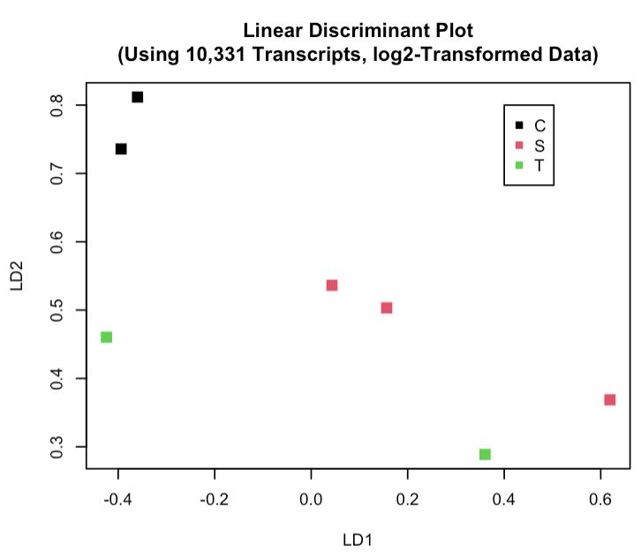
#Classification methods: LDA
# Linear Discriminant Analysis.
#LDA test was performed
on 16 train samples and
7 test samples.
Confusion matrix
C S T
C 0 0 0
S 2 2 2
T 0 1 0
C, Control biopsy
S, sarcoidosis granulomas
T, tuberculous granulomas
Yellow, misclassified test samples
Notes:
https://www.listendata.com/2015/02/splitting-data-into-training-and-test.html

Slide 18
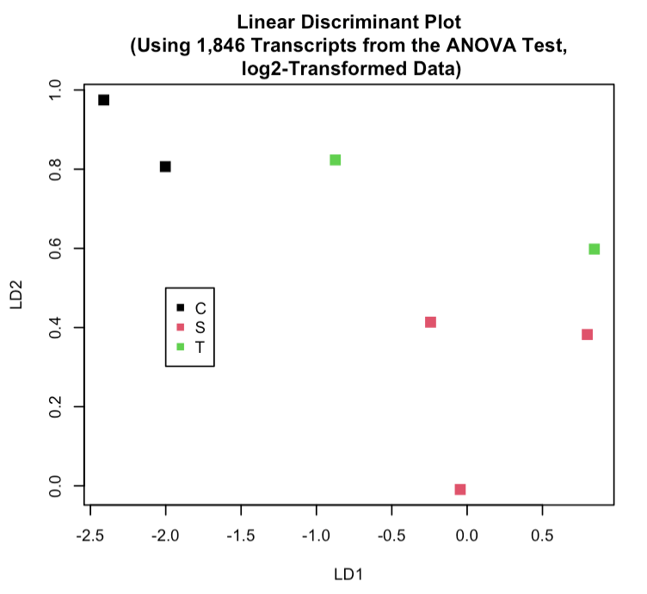
#Classification methods: LDA
#Linear Discriminant Analysis on 1,846 transcripts identified by the ANOVA test.
#LDA test was performed on 16 train samples and 7 test samples.
Confusion matrix
C S T
C 2 0 0
S 0 2 1
T 0 1 1
C, Control biopsy
S, sarcoidosis granulomas
T, tuberculous granulomas
Yellow, misclassified test samples

Slide 19
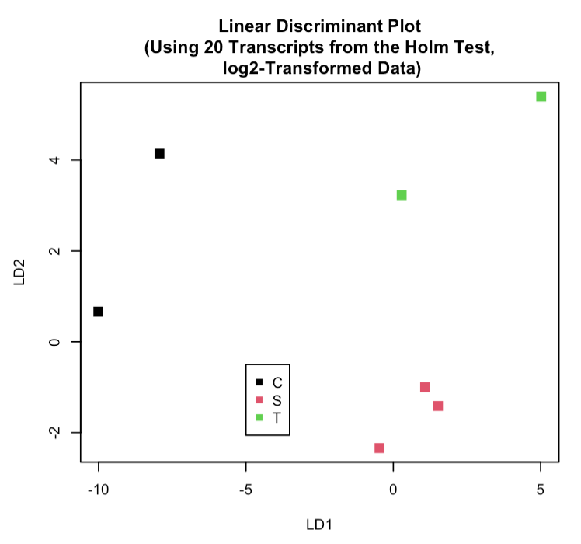
#Classification methods: LDA
#Linear Discriminant Analysis on 20 transcripts identified by Holm test.
#LDA test was performed on 16 train samples and 7 test samples.
Confusion matrix
Co Sa TB
Co 2 0 0
Sa 0 3 0
TB 0 0 2
C, Control biopsy
S, sarcoidosis granulomas
T, tuberculous granulomas

Slide 20
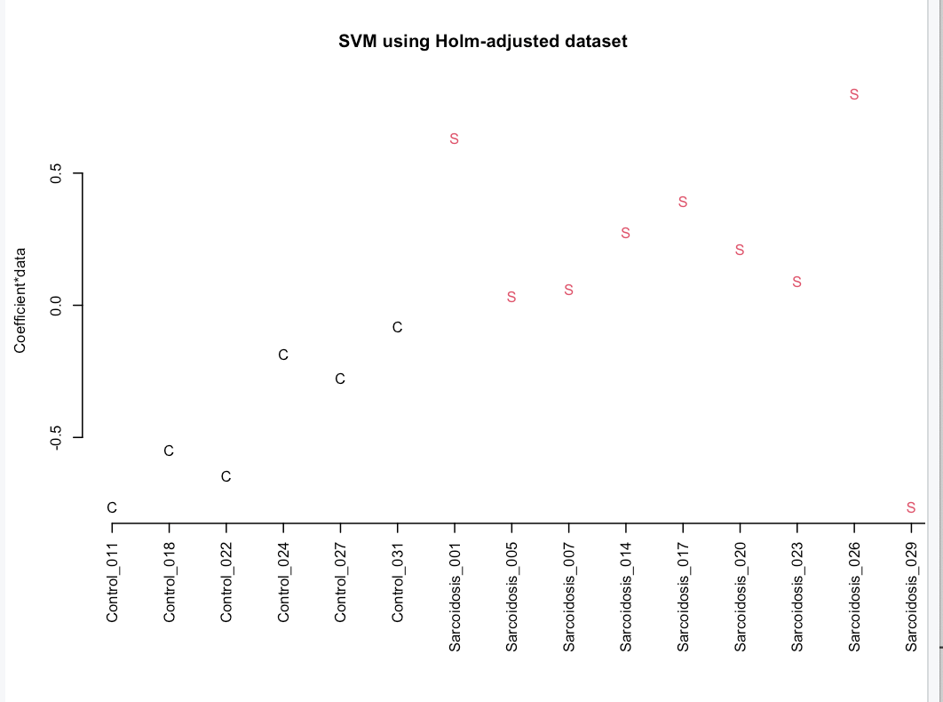
#Classification methods: SVM
#Support vector machine algorithm (SVM)
#SVM test was performed on 20 transcripts identified by Holm test.
Confusion matrix
C S T
C 6 0 0
S 0 10 0
T 0 1 6
C, Control biopsy
S, sarcoidosis granulomas
T, tuberculous granulomas
Yellow, misclassified samples

Slide 21
#Select Differentially Expressed Transcripts
#Volcano Plots (between 3 groups comparisons of 10,331 transcripts)
C, Control biopsy group
SC, sarcoidosis granulomas group
TB, tuberculous granulomas group
Red dots, >2 log-fold upregulated transcripts
Green dots, >-2 log-fold downregulated transcripts

Slide 22
#Select Differentially Expressed Transcripts
#Volcano Plots
for groups comparisons:
(1) Control vs Sarcoidosis;
(2) Control vs Tuberculosis.
T-test was done on 1,846 transcripts (identified in ANOVA with p-values < 0.05)
(1)
(2)
C, Control biopsy group
SC, sarcoidosis granulomas group
TB, tuberculous granulomas group
Red dots, >2 log-fold upregulated transcripts
Green dots, >-2 log-fold downregulated transcripts

Slide 23
#Selection of top 5 significantly up- and down- regulated genes
#Volcano Plots
for groups comparisons:
Control vs Sarcoidosis;
(2) Control vs Tuberculosis.
T-test was done on 20 transcripts identified by the Holm Test.
(1)
(2)

Slide 24
# Top10 Significantly Up- and Down- Regulated Genes ³
Genes | CvsSC pvalue | CvsSC FC | CvsTB pvalue | CvsTB FC | GO, biological process | Cellular Pathway | name
CHI3L1 | 6.50E-10 | -6.633524 | 1.24E-05 | -5.509 | inflammatory response | regulation of neutrophil chemotaxis | chitinase 3 like 1
C15orf48 | 1.94E-09 | -5.648423 |  |  | oxidation-reduction | ion transport | chromosome 15 open reading frame 48
HLA-DQB2 | 8.19E-09 | -3.725602 |  |  | innate immune response | antigen processing and presentation | Major Histocompatibility Complex, Class II, DQ Beta 2
CLEC7A | 1.13E-06 | -4.127716 |  |  | innate immune response | pattern recognition receptor signaling | C-type lectin domain family 7 member A
NUPR1 | 5.81E-07 | -3.780972 |  |  | inflammatory response | regulation of transcription by RNA polymerase II | Nuclear protein 1, short sequence motif:Nuclear localization signal
DSP | 5.27E-05 | 2.236074 |  |  | Glycolysis / Gluconeogenesis | ethanol oxidation | Alcohol dehydrogenase 1B, chain
CCL21 | 5.27E-05 | 2.236074 | 4.80E-06 | 5.06672 | immune response | Chemokine signaling | C-C motif chemokine ligand 21
ABCA8 | 1.72E-05 | 3.116552 |  |  | xenobiotic transport | ABC transporter | ATP binding cassette subfamily A member 8
C7 |  |  | 3.60E-05 | 4.18334 | innate immune response | complement activation signaling | complement C7
MATN2 | 1.84E-05 | 3.136921 |  |  | calcium ion binding | cell migration | matrilin 2
#Volcano Plots
for groups comparisons:
CvsSC, Control
vs Sarcoidosis;
CvsTB, Control vs Tuberculosis.
FC, log fold change.
³ https://david.ncifcrf.gov/tools.jsp

Slide 25


#Conclusions
One outlier was identified and removed from dataset.
10,331 transcripts were retained for analysis after removing low- expressed transcripts.
1,846 transcripts were retained in ANOVA analysis (p<0.05), and only 20 were identified after multiple testing correction.
Tuberculosis and sarcoidosis granulomas had overlapping transcriptional profiles and were segregated poorly from each other, as determined via different dimensionality reduction and classification methods.
Linear Discriminant Analysis showed significant improvement (less misclassified samples) when group analysis was done on a subset of genes identified by Holm adjustment test (as compared to a subset identified by ANOVA or entire dataset).

Slide 26
#Conclusions
Support vector machine algorithm (SVM) revealed misclassification of one test sample.
T-test and Log-fold comparisons identified numerous transcripts that were up- or down- regulated in the Control tissues as compared to Tuberculosis and Sarcoidosis granulomas.
Top 10 up- and down- regulated genes had various Gene Ontology functions, including inflammation and innate immune responses.
Top 10 transcripts encode for proteins that function within intracellular immune and transporter pathways.
In summary, we corroborated authors’ findings ².

Slide 27
# References
¹ GEO accession: GSE174443 https://www.ncbi.nlm.nih.gov/geo/query/acc.cgi?acc=GSE174443
² Michaela T Reichmann at.al. Integrated transcriptomic analysis of human tuberculosis granulomas and a biomimetic model identifies therapeutic targets. J Clin Invest. 2021 Aug 2;131(15):e148136.
³ The Database for Annotation, Visualization and Integrated Discovery (DAVID ) v6.8 https://david.ncifcrf.gov/

